Slide 1
Impact of digital transformation and the pandemic on KAM
Dr. Deva Rangarajan

Slide 2
Agenda
B2B Customer Trends
Sales and COVID-19
The Evolving Key Account sales process
Key Tips for Key Account Professionals
Q&A

Slide 3
B2B Customer Experience Trends
77% of B2B buyers consumer content online
5 pieces of content are consumed by customers
57% of the buying decision is made prior to engaging with sales
30% of B2B decisions are made by a committee of 5 members, 70% by 2 members
80% of B2B companies implementing e-commerce believe that consumer practices have changed expectations
Source: Forrester Research, Gartner, SiriusDecisions, CSO Insights

Slide 4
B2B Customer Experience Trends
76% of B2B customers want information that is easy to find on the supplier website
50% of B2B customers want personalized information being made available on online formats
75% of buyers are influenced by social selling
Source: Forrester Research, Gartner, SiriusDecisions, CSO Insights

Slide 5
Sales and COVID-19
Buyers putting off non-essential purchases.
Buyers looking for continuity in the supply-chain and for alternate sourcing.
Buyers are overloaded with information from suppliers
Buyers do not like aggressive approaches by salespeople
Buyers are looking for new insights into value creation from their suppliers- need not always be about new product innovations, it can be about process innovations, sourcing innovations, financial innovations, etc.
Sourcing managers in B2B firms are the people you need to talk to if you have to find out who is responsible for making decisions.
Source: Interviews with sales professionals and buyers- April 2021

Slide 6
The Empowered Buyer
Increased visibility of the buyer in the customer’s organization
Increased focus on not just reducing material spend but also on other transaction costs (transportation costs, insurance costs, financing costs, inventory management costs, etc)
Reducing risk exposure
Demand for price transparency (open book pricing)
Vendor Optimization is a strategic priority

Slide 7
The Ever Evolving Sales Process
Enduring Shifts in Customer Behaviors
Customers Move to Reduce In-Person Interactions
Customers Using More Digital Technologies
Evolving Key Account Sales Processes
Opportunity Management
Approach
The Increase in Digital Transformation
People
Performance
Customers’ Information Overload and Need for Personalized Content
Presentation/Objection Handling/Close
Follow-up

Slide 8
Opportunity Management
Pre-COVID
Post-COVID
Fairs
Exhibitions
SEO
Annual Reports of Customers
CRM
Fairs
Exhibitions
Webinars
White papers
Blogs
Social Media
Marketing Automation
Social Listening

Slide 9
Approach and Presentation
Pre-COVID
Post-COVID
Face to Face
Brochures
Physical Collateral
Face to Face
Zoom/Teams
Hybrid
Digital Collateral

Slide 10
Approach and Presentation
Pre-COVID
Post-COVID
Face to Face
Calls
Reactive Engagement
Face to Face
Account Based Marketing
Value Demonstration/Customer Success
Proactive Engagement

Slide 11
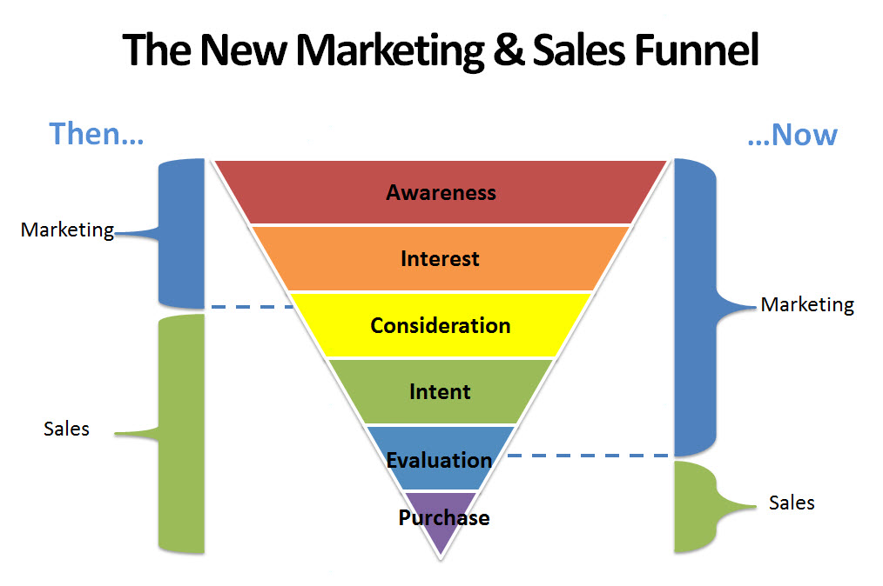
The New Reality of the B2B Key Account Sales Process
Source: SIRIUSDECISIONS

Slide 12
Key Tips for Key Account Managers
Managing your key customer relationships
Re-evaluate your customer portfolio to reflect changes to customer situations
Existing value propositions to customers MUST be reassessed and customer resistance to new value propositions MUST be anticipated
Your customers might be ready (if not already) for hybrid sales approaches
Marketing can be a great resource throughout the sales process
Social Media is a great medium to build your personal brand

Slide 13
Key Tips for Key Account Leaders
Managing key customer relationships
Increase key account support
Address Change Resistance by KAMs and Customers
Understand the Impact of Technology
Enhance Training and Development of KAMs
Reassess your KAM KPIs

Slide 14
Jack Welch
“The winners will be those who deliver solutions from the user’s point of view”

Slide 15
Thank you
Contact: d.rangarajan@ieseg.fr
LinkedIn: https://www.linkedin.com/in/devarangarajan/

