Slide 1



Contract disputes &
how to avoid them
Friday 21st July, 2023
11:15-12:15 pm BST |
12:15-1:15 pm CET
Jeremy Newton,
Director, Codified Legal

Slide 2

Webinar protocols
Questions will be addressed at the end of the presentation.
Please ask your questions throughout the presentation by typing into the Q&A or chat box.
(see bar at bottom of Zoom screen)
Please email info@a4kam.org if you have questions afterwards.
The webinar will be recorded and available in member resources.

Slide 3
Outline
Introduction
Why bother with contracts?
Common causes of contract disputes
Three key legal issues for Key Account Managers
    Charging arrangements
    Term and termination
    Liability
Efficient contracting processes
Getting the most out of your legal adviser
Conclusion

Slide 4
Why bother with contracts? (1)
No legal requirement for most contracts to be in writing…
But good practice to document agreed terms
Express terms in written contracts displace implied terms
    e.g. “satisfactory quality”, “reasonable care and skill”
Inadequate paperwork a common cause contract disputes

Slide 5
Why bother with contracts? (2)
Function of the written contract
  Capture all the relevant terms agreed between the parties
  Provide a clear record in the event of problems or disagreements down the line about what was agreed
Function of the negotiation process
  Clarify the parties’ expectations
  Identify disconnects
  Resolve ambiguities and inconsistencies
  Ensure clarity about each party’s rights and obligations

Slide 6
Why bother with contracts? (3)
Broad types of contractual provision
  “Contract mechanics” – e.g. who does what and when?
  Commercial highlights – e.g. term, price, IPR ownership
  Problem management – e.g. warranties, remedies, liability (the “what-ifs”)
Lawyers tend to focus on the what-ifs
  But should also understand the wider technical/commercial context
Business people tend to focus on the technical/commercial side
  But should also be aware of the what-ifs

Slide 7
Common causes of contract disputes
Most disputes are nothing to do with contract wording as such
  Customer conduct like non-payment or persistent late payment
  Supplier conduct like non-delivery or late delivery
  Quality issues / staff issues / confidentiality issues
But many are
  Lack of clarity in charging arrangements
  Lack of certainty about deliverables or timings
  Lack of forethought about duration, renewal and price increases
Ambiguity is usually avoidable – if you pay attention to the wording!

Slide 8
Three common problem areas in contract drafting
Charging arrangements
Term and termination
Liability
NB: there are plenty of others

Slide 9
Charging arrangements (1)
Why do the charging provisions matter contractually?
Common problem areas
  Lack of clarity
  Complicated fee/price structures
  Insufficient explanation of their interplay
  Failure to “future proof”
  Charging arrangements are a key business matter –
  but the legal adviser can help ensure clarity

Slide 10
Charging arrangements (2)
  Break everything down into clearly-headed sections
    What are the elements of the charges?
      e.g. for a major IT project: hardware costs, licence fees, implementation fees, support fees
    How is each of those items calculated?
      e.g. price per unit or user, volume bandings, rate cards, discounting arrangements and conditions
    When is each element of the charges payable?
      e.g. on signature, on delivery, quarterly in advance, monthly in arrears
    What is the invoicing process?
      e.g. when can the supplier issue an invoice, what supporting information is needed?
    What are the payment terms?
    What expenses are recoverable?
    How are price increases regulated?
      e.g. RPI + 2%, CPI – 1%, other

Slide 11
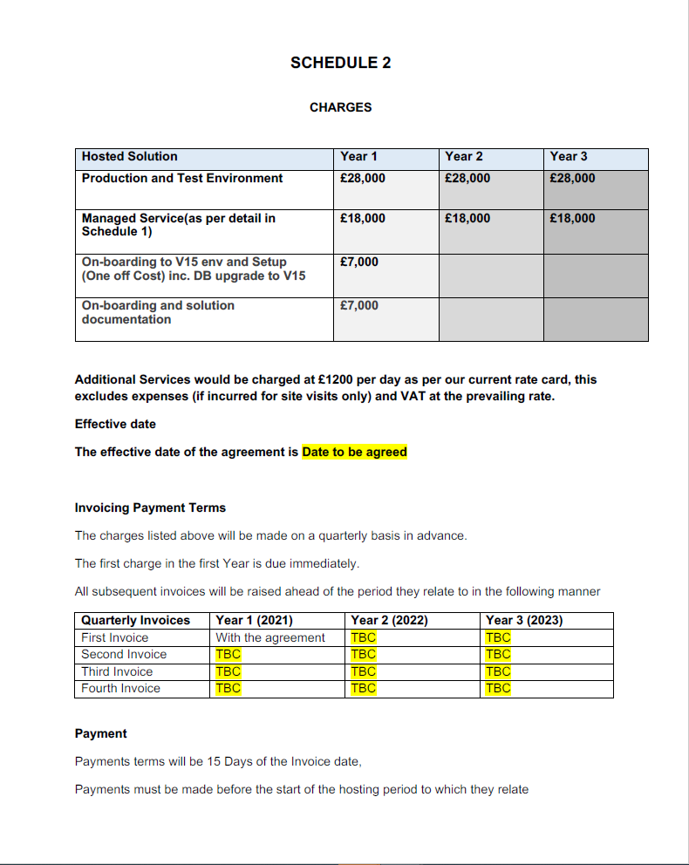
Charging arrangements (3) – sample clause for discussion

Slide 12
Term and termination (1)
Why does the Termination clause matter contractually?
  Regulates how long the contract will last
  Critical to the supplier from the revenue point of view
  Critical to the customer from the continuity point of view
Common problem areas
  Lack of clarity in drafting
  Termination notice periods
  Automatic renewals
  Contract term is a key business decision - don’t leave it to the lawyers

Slide 13
Term and termination (2)
Basic fixed term clause
  x.1 This Agreement will remain in force for 3 years from the Contract Date, and will terminate automatically on the expiry of that period.
Automatic renewal
  x.1 This Agreement will remain in force for 3 years from the Contract Date (“the Initial Period”).
  x.2 On expiry of the Initial Period, this Agreement will remain in force for successive periods of 3 years (“Renewal Periods”), unless terminated by 90 days’ notice expiring at the end of the Initial Period or any Renewal Period.
Automatic expiry with option to renew
  x.1 This Agreement will remain in force for 3 years from the Contract Date (“the Initial Period”).
  x.2 On expiry of the Initial Period, this Agreement will terminate automatically, unless the Customer gives notice no later than 90 days before the end of the Initial Period that it wishes to renew this Agreement, in which event this Agreement will remain in force for a further period of 3 years.

Slide 14
Term and termination (3)
Even a simple Term clause needs consideration from several angles
Duration of Initial Period and Renewal Period?
  Balance up predictability of performance against risks of being tied-in
Automatic renewal or renewal on notice?
  A matter of internal management and policy for the parties – not a legal point
Notice periods: length and expiry date?
  No logical reason why notice periods have to be symmetrical
  e.g. 30 days’ notice to terminate from the Customer, but 90 days from the Supplier

Slide 15
Term and termination (4)
Common termination events
  Breach (or material breach)
  Persistent force majeure preventing performance
  Insolvency
  Change of control
“Breach” vs. “material breach”
  Termination for any breach “flies in the face of commercial common sense”
  Impossible usefully to define “material breach”…
  … but always advisable to specify instances where possible

Slide 16
Term and termination (5)
Other termination events (depending on nature of contract)
  Failure to achieve defined service levels or target dates
  Performance prevented by changing laws or regulations
  Withdrawal of regulatory permits etc
  Acquisition by a party (cf. change of control of a party)
  Staff attrition rates exceed a specified threshold
… and an unlimited variety of other situations and anxieties

Slide 17
Term and termination (6)
Don’t forget exit planning: essential for service continuity
Include at least general assurances regarding exit
  Migration of data
  Return of confidential information
  Bid assistance and co-operation with new incoming providers
Ideally incorporate at least a model exit plan in the initial contract
  Review it regularly
  Keep asset inventory updated
  Address shared use assets, post-contract IPR arrangements, third party contracts
  Provide for payment for exit assistance
  NB: don’t leave exit planning until the point that expiry or termination is imminent – know in advance how exit will work

Slide 18
Term and termination (7)
Don’t forget exit planning: essential for service continuity
Include at least general assurances regarding exit
  Migration of data
  Return of confidential information
  Bid assistance and co-operation with new incoming providers
Ideally incorporate at least a model exit plan in the initial contract
  Review it regularly
  Keep asset inventory updated
  Address shared use assets, post-contract IPR arrangements, third party contracts
  Provide for payment for exit assistance
  NB: don’t leave exit planning until the point that expiry or termination is imminent – know in advance how exit will work

Slide 19
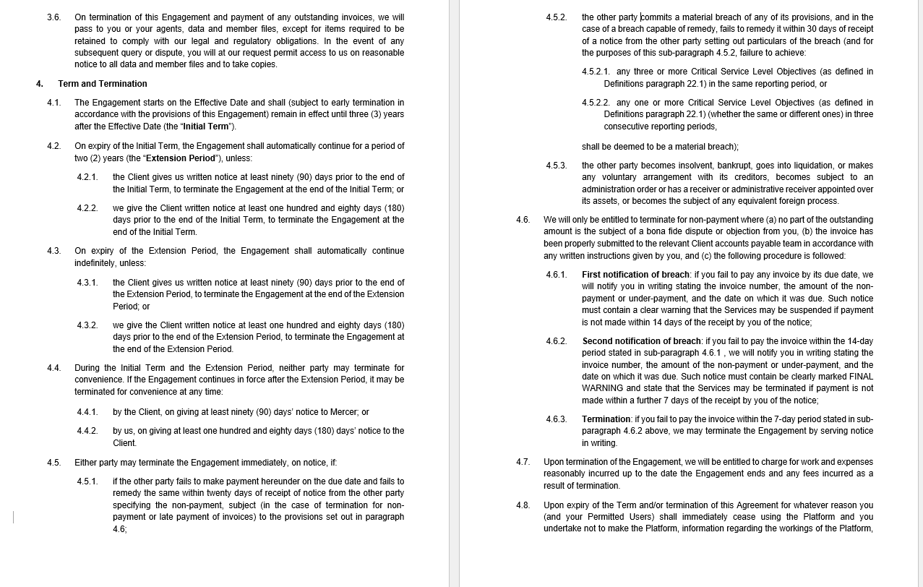
Term and termination (8) – sample clause for discussion

Slide 20
Liability (1)
Why does the Liability clause matter contractually?
  Regulates the parties’ exposure in the event of default
Common problem areas
  Lack of clarity in drafting
  Vaguely worded exclusions
  “Indirect” and “consequential” loss issues
  Financial caps
Liability is a key risk-management provision - don’t leave it to the lawyers

Slide 21
Liability (2)
Why limit liability?
  Restrict recoverable losses arising from breach of contract or negligence
Common types of limitation
  Types of loss - e.g. “indirect”, “consequential”, “loss of profits”
  Financial caps – e.g. £x per event or in aggregate
  Procedural limits - e.g. all claims to be brought within 12 months
  “Indirect” and “consequential” loss are imprecise expressions. It is almost impossible to avoid using them, but good practice is also to identify and allocate responsibility for specific types of foreseeable loss

Slide 22
Liability (3)
Other challenges with liability clauses
  Standard wording is often archaic and/or irrelevant
  Clauses are always open to judicial interpretation
  Courts apply “contra proferentem” rules of construction
  Courts can also apply “reasonableness” test in some situations
Parties are often reluctant to depart from corporate policy
  “We never accept liability for consequential loss”
  “We never agree more financial exposure than 1 x annual fees”
  “We expect the supplier to accept uncapped liability for any breach”

Slide 23
Liability (4)
How to draft a liability clause
  Building your clause “from the ground up”
  Start by analysing likely types of loss before looking at “standard” drafting
Step 1 – Recognise that some liabilities cannot be excluded, by law
  e.g. death or personal injury caused by negligence, fraud
Step 2 – Identify and allocate foreseeable liabilities
  Identify and discuss specific known risks as part of good risk management
  Beware using vague concepts like “consequential loss”

Slide 24
Liability (5)
Step 3 – Other kinds of liability can then be excluded by agreement
  e.g. “consequential loss” and other catch-alls
  State that losses identified in Step 2 are outside this category
Step 4 – Apply any agreed financial limitations
  Figures applicable to agreed categories of loss
  Per event and aggregate caps
Step 5 – Apply any procedural limitations
  e.g. time limits for notification of claims

Slide 25
Liability (6) – sample clause for discussion
WE AND OUR AFFILIATES AND LICENSORS WILL NOT BE LIABLE TO YOU FOR ANY INDIRECT, INCIDENTAL, SPECIAL, CONSEQUENTIAL OR EXEMPLARY DAMAGES (INCLUDING DAMAGES FOR LOSS OF PROFITS, REVENUES, CUSTOMERS, OPPORTUNITIES, GOODWILL, USE, OR DATA), EVEN IF A PARTY HAS BEEN ADVISED OF THE POSSIBILITY OF SUCH DAMAGES. FURTHER, NEITHER WE NOR ANY OF OUR AFFILIATES OR LICENSORS WILL BE RESPONSIBLE FOR ANY COMPENSATION, REIMBURSEMENT, OR DAMAGES ARISING IN CONNECTION WITH: (A) YOUR INABILITY TO USE THE SERVICES, INCLUDING AS A RESULT OF ANY (I) TERMINATION OR SUSPENSION OF THIS AGREEMENT OR YOUR USE OF OR ACCESS TO THE SERVICES OR AWS CONTENT, (II) OUR DISCONTINUATION OF ANY OR ALL OF THE SERVICES OR AWS CONTENT, OR, (III) WITHOUT LIMITING ANY OBLIGATIONS UNDER THE SERVICE LEVEL AGREEMENTS, ANY UNANTICIPATED OR UNSCHEDULED DOWNTIME OF ALL OR A PORTION OF THE SERVICES FOR ANY REASON; (B) THE COST OF PROCUREMENT OF SUBSTITUTE GOODS OR SERVICES; (C) ANY INVESTMENTS, EXPENDITURES, OR COMMITMENTS BY YOU IN CONNECTION WITH THIS AGREEMENT OR YOUR USE OF OR ACCESS TO THE SERVICES OR AWS CONTENT; OR (D) ANY UNAUTHORIZED ACCESS TO, ALTERATION OF, OR THE DELETION, DESTRUCTION, DAMAGE, LOSS OR FAILURE TO STORE ANY OF YOUR CONTENT OR OTHER DATA. IN ANY CASE, EXCEPT FOR PAYMENT OBLIGATIONS UNDER SECTION 7.2, OUR AND OUR AFFILIATES’ AND LICENSORS’ AGGREGATE LIABILITY UNDER THIS AGREEMENT WILL NOT EXCEED THE AMOUNT YOU ACTUALLY PAY US UNDER THIS AGREEMENT FOR THE SERVICE THAT GAVE RISE TO THE CLAIM DURING THE 12 MONTHS BEFORE THE LIABILITY AROSE. THE LIMITATIONS IN THIS SECTION 9 APPLY ONLY TO THE MAXIMUM EXTENT PERMITTED BY APPLICABLE LAW.

Slide 26
The contract negotiation process (1)
Getting the right starting point
  Where do contracts come from?
  Supplier’s standard terms: are they negotiable?
  Existing contractual arrangements with the supplier
  Customer’s own procurement contract
  Other sources
Points to agree upfront
  The starting point
  Control of the document
  Document management and version control
Consolidating disparate information – “cludging”

Slide 27
The contract negotiation process (2)
Seamless interplay of “legal”, “commercial” and “technical” paperwork
  Specification, pricing, project plan etc. should be grounded in main T&Cs
  Term, termination, liability, warranties, indemnities etc. are all key commercial issues – they go to the risk profile of the relationship
What does a good legal adviser do?
  Provide expertise and knowledge of the particular kind of agreement
  Ask questions - what, where, when, why, how, who? Simple questions can highlight points of misunderstanding
  Spot ambiguity
  Never take anything at face value
  Find pragmatic solutions to contractual sticking-points
  Adopt an impartial “risk challenge” role
  Use clear and effective wording and reduce ambiguities

Slide 28
Conclusion
Some final do’s and don’ts…
  Don’t be afraid of legal drafting – there’s no magic to it
  Do insist on archaic or difficult language being clarified
  Don’t put off dealing with “the legal bits” – it will only cause delay
  Do overrule your legal advisers if they aren’t helping
  Don’t become a slave to “corporate policy” or “legal policy”
  Do explore pragmatic solutions – few contract issues are entirely binary
  Most contracts and clauses are negotiable to some extent
  Account managers should take an active role in negotiating the key issues
  Lawyers should understand the client’s business –
  and speak the client’s language

Slide 29



How are you developing your career?
PostGraduate Certificate in KAM
Designed for working key account managers anywhere
In your spare time, totally online, applied to your business
https://a4kam.org/postgraduate/
Key Account Manager of the Year Award
• What have you done for your customer and your company?
• Gain recognition for your work in just 500 words!
https://a4kam.org/key-account-manager-of-the-year/
It should be you! Applications for either by 30th November
Sandro Clos,
KAM of the Year 2022
Thierry Josselin,
KAM of the Year 2021

Slide 30




Upcoming Events
Friday 15th September 2023
Webinar: Account Based Marketing (ABM)
Andrea Clatworth, Head of Europe Marketing Transformation Projects, Fujitsu
Friday 10th November 2023
Online full 3-session meeting
Kim Arnold - How to build better remote relationships with clients
Vagner Pin - Pfizer Brazil
Jens Hentschel – Building bridges between Procurement and KAM
As interactive as you can get online!
Kim Arnold
Jens Hentschel

Slide 31
Any questions?
Jeremy Newton
Jeremy.Newton@Codified.Legal
Mobile: +44 (0) 7749 631 620
Codified Legal Limited
www.Codified.legal

