Slide 1




Practicalities of strategic account planning
Geoff Quinn
Pfizer Global
Diana Woodburn
AKAM Chair
Professionalising Key Account Management | a4kam.org

Slide 2
What’s on the agenda today?
What is strategic account planning?
Who expects what from strategic account plans?
The essential components of strategic account plans
Strategic account plan review
Why are strategic account plans so often poor or non-existent?

Slide 3
Poll
According to a recent global CSO Insights Sales Enablement Optimization Study what %age said that …….
…… strategic account planning wasn’t relevant to them?
  10%
  20%
  30%
  40%

Slide 4
A few thoughts …..
According to a recent global CSO Insights Sales Enablement Optimization Study:
Of those studied …..
10.4% said that strategic account planning wasn’t relevant to them and therefore they wouldn’t do it
*Frank Dale CEO & Co-Founder Open View Partners, 5 Important Elements For Strategic Account Planning Sessions, OV blog, March 26, 2018
https://openviewpartners.com/blog/strategic-account-planning/#.XuyxETd8DIW

Slide 5

Three little words
Strategic…. “relating to the identification of long-term or overall aims and interests and the means of achieving them”
Account…. “an identified entity of interest”
Plan…. “an intention or decision about what one is going to do”
Account Plan….
  “a single document that contains important details, including information about the accounts decision-making process, the competition and the overall strategy to win them over (and retain them)”*
  “Organisations which invest resources in detailed analysis of the needs and processes of their key accounts fare much better in building long-term profitable relationships”**
*Shabnam Kakar, Cooper Chronicles blog June 18, 2019
**Ryals, L. and McDonald, M., 2008. Key account plans: The practitioners' guide to profitable planning. Routledge.

Slide 6
Poll
According to a recent global CSO Insights Sales Enablement Optimization Study what %age said that …….
…… account planning is ‘left to’ the sales professional
  15%
  25%
  35%
  45%

Slide 7
A few thoughts …..
According to a recent global CSO Insights Sales Enablement Optimization Study:
Of those studied …..
10.4% said that strategic account planning wasn’t relevant to them and therefore they wouldn’t do it
24.8% said that account planning is ‘left to’ the sales professional
*Frank Dale CEO & Co-Founder Open View Partners, 5 Important Elements For Strategic Account Planning Sessions, OV blog, March 26, 2018
https://openviewpartners.com/blog/strategic-account-planning/#.XuyxETd8DIW

Slide 8

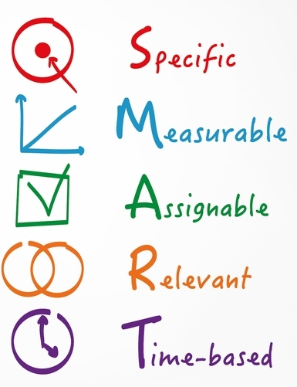
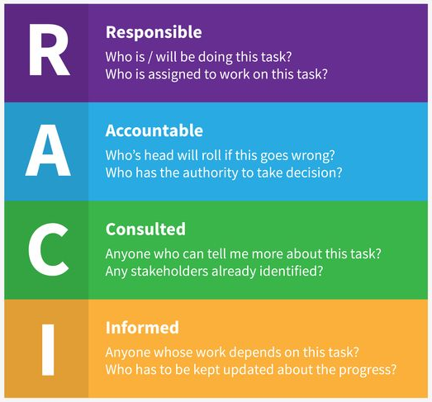

Expectations
Single, central source of truth
Updated & accessible
Internally & externally focused
Responsible / Accountable / Consulted / Informed
Creating / Engaging / Delivering
An insurance policy
Interesting
Detailed

Slide 9
Poll
According to a recent global CSO Insights Sales Enablement Optimization Study what %age said that …….
…… sales professionals are required to develop strategic account plans?
  25%
  33%
  50%
  66%
  75%

Slide 10
A few thoughts …..
According to a recent global CSO Insights Sales Enablement Optimization Study:
Of those studied …..
10.4% said that strategic account planning wasn’t relevant to them and therefore they wouldn’t do it
24.8% said that account planning is left up to each sales professional
33.1% said that sales professionals are required to develop strategic account plans
*Frank Dale CEO & Co-Founder Open View Partners, 5 Important Elements For Strategic Account Planning Sessions, OV blog, March 26, 2018
https://openviewpartners.com/blog/strategic-account-planning/#.XuyxETd8DIW

Slide 11
Critical importance of the plan
Added value
The customer
Shared learning
Key account plan
Delivering the vision
3-5 years
Peers and functions
Corporate business plan
Key account team
Professor Patrick Godfrey, Halcrow Strategic Relationship Director
Team success

Slide 12
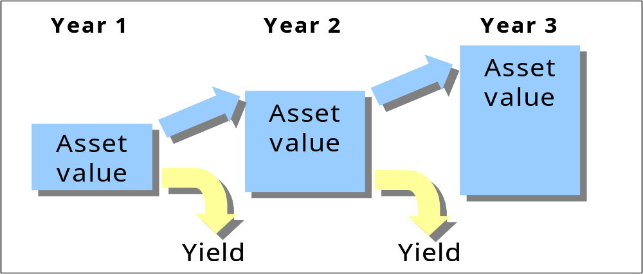
Securing resources
Investment
Business case
development or maintenance of an asset
increase in value
short-term yield
longer-term return

Slide 13


The elements of the plan
Seek to understand
  Vision
  SWOT, PESTLE etc.
Value identification
  Competitive analysis
  Offer detail
Delivery
  Contracting
  Milestones and exit
Engagement
  Who, how and when
Relationship management
5. Communication
1. Customer & account understand-ing
3. Value creation & offers
4. Commitment delivery & measurement
2. Supplier organisation understanding
Relationship management

Slide 14
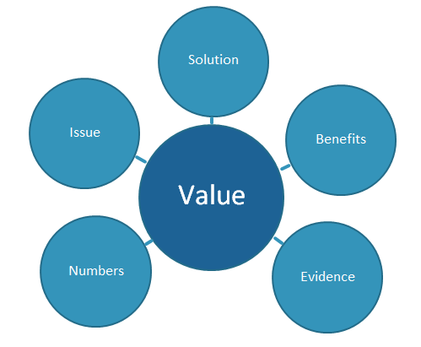
Five key features of a value proposition
Issues faced in relation to current and future practice
  What problem that is being addressed
  What is the cost to the account of doing nothing?”
How will the proposal provide a solution
  Does the proposed solution offer an advantage over currently approved or existing solutions?
Detail the benefits for the account and their customers over and above, or instead of, current practice.
Look at the financial case and cost effectiveness.
  Detail the resource use and cost savings delivered over and above, or instead of, current practice; look at all costs versus savings and return on investment.
Substantiate all claims with real evidence demonstrated from validated evaluations
  Consider whether you have the resources to carry out a small-scale test.
A Strong Value Proposition: The Key to Engaging the NHS in 2019 for SMEs
Journal of mHealth https://thejournalofmhealth.com/a-strong-value-proposition-the-key-to-engaging-the-nhs-in-2019-for-smes/
Notes:
1. Issues faced in relation to current and future practice. It’s important to bear in mind the scale of the problem that is being addressed and ask yourself questions like “What is the cost to the account of doing nothing?”
2.How will the proposed product or service provide a solution to this problem and “How does the proposed solution offer an advantage over currently approved or existing solutions?”
3.Detail the benefits for the account and their customers over and above, or instead of, current practice.
4.The numbers, look at the financial case, and cost effectiveness. Detail the resource use and cost savings delivered over and above, or instead of, current practice; look at all costs versus savings and return on investment.
5. Substantiate all claims with real evidence demonstrated from validated evaluations, and perhaps even consider whether you have the resources to carry out a small-scale test.

Slide 15
The objective: strategic account plans
Writing
The plan
Where are we now?
Customer understanding
Your strategies & objectives
High level action & review
Appendices
Background detail
Business analysis
Development of thinking
Executive summary
Reading

Slide 16
Creating and using a strategy scorecard
Strategy prioritisation criteria: examples | Weight | Strategy A |  | Strategy B |  | Strategy C etc …
 |  | Rating 0-10 | Score W x R | Rating 0-10 | Score W x R | Rating 0-10 | Score W x R
Contributes to our corporate strategy | 35
Well aligned with customer corporate strategy | 30
Replaces low margin products with high margin services | 15
Opportunities to build wider relationship with customer | 10
Builds our position as leaders in the marketplace | 10
Total | 100
Score = weight x rating (0 – 10)

Slide 17
Measurement basics
Focus on purpose and response
WHY?
E.g. Improve relationship
Stay on track
WHAT?
Purpose-driven
outcomes, not just
outputs
HOW?
Flexible
Driven by supplier &
customer needs
Now you know, what are you going to do about it?

Slide 18
Why measure? Purpose
Making the right strategic decisions
Evidence-based decisions
Objective assessment of KAM strategies
Maximises ROI
Converts strategy into implementation
Tracks progress against plan
Internal and external alignment with customer
Internal alignment: achieving motivation
Pinpoints underlying problems
Aligning implementation
with strategy
Improving efficiency and productivity
Opportunities for performance improvement
Objective monitoring
Shows value of KAM internally
Creates the language and understanding for powerful communication
Improves multi-function co-operation
Gaining
visibility
Learning and improvement

Slide 19
Who cares?
Making the right strategic decisions
Strategy
PROFIT
Aligning implementation
with strategy
Realisation
VALUE
Improving efficiency and productivity
Operations
(Transactions/Process/Project)
PRICE/PERFORMANCE
SUPPLIER
CUSTOMER
Alignment of measurement

Slide 20
Balance metrics between inputs and outcomes
YOUR COMPANY
‘Lead’ indicators
‘Lag’ indicators
Measurements of inputs/actions
Measurements of outputs/outcomes
CUSTOMER
KAM input
Completion of actions
Customer attractiveness
Customer risk
Customer satisfaction
Contacts, meetings
Relationship
Sales?
Business extension
Customer retention
Customer profitability

Slide 21
3-way balanced plan metrics
Strategic/Board level interest
Inputs
Company & specific account
Outcomes
Operational level interest

Slide 22
Strategic account plan review (with or without the customer?)
Establish a rhythm
  Quarterly – operational, near term, issues, progress & plan
  Twice yearly – leading, co-creation review, best practice, ideation
  Yearly – board to board, performance, strategic view, critical need
What should you review?
  Value co-creation and delivery
  Clarify the desired outcomes -> operational improvement
  Relationships

Slide 23
Poll
According to a recent global CSO Insights Sales Enablement Optimization Study what %age said that …….
…… salespeople are “encouraged” to develop strategic account plans
  25%
  33%
  50%
  66%
  75%

Slide 24
A few thoughts …..
According to a recent global CSO Insights Sales Enablement Optimization Study:
Of those studied …..
10.4% said that strategic account planning wasn’t relevant to them and therefore they wouldn’t do it
24.8% said that account planning is left up to each sales professional
33.1% said the sales professionals are required to develop strategic account plans
31.7% said that salespeople are “encouraged” to develop strategic account plans
Conclusion - Over 50% of sales professionals don’t take advantage of account planning to map out how they pursue their strategic accounts
*Frank Dale CEO & Co-Founder Open View Partners, 5 Important Elements For Strategic Account Planning Sessions, OV blog, March 26, 2018
https://openviewpartners.com/blog/strategic-account-planning/#.XuyxETd8DIW

Slide 25
Why are they so often poor?
Skill - the ability to do something well; expertise
Knowledge - the theoretical or practical understanding of a subject
Attitude - a settled way of thinking or feeling about someone or something
Lack vision of a ‘future state’
Internally focused
Lack collaboration
Creativity limited
Revenue AND margin
Too complicated
A ‘one-off’
Too operational
Focused on self
No Value Proposition!!

Slide 26
Final thoughts
Surely the amount of busines delivered by a key account demands a plan?
How do you know where you are going if you don’t have a plan?
How does anyone know where you are going if you don’t have a plan? Customer? Senior management? Delivery functions?
Do you believe in your plan?
Does everyone involved know what’s in your plan?

Slide 27
Next webinar
30̊̊⁰
Summer break until September
Friday 4th September
Leading in a virtual workspace
Dr Colin Hughes, Technological University Dublin
To follow:
Sharing customer knowledge - a total organisational approach
Jeremey Campbell & Steve Dolan, Emcor

